Slide 1
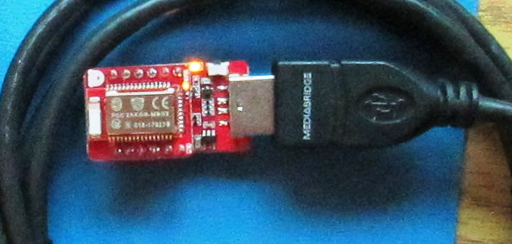
nRF52832 Read / Write to Cell Phone, via Red Bear BLE Nano 2 device.
https://redbear.cc/ ->
Now part of particle -> https://store.particle.io/
Development Env.
Arduino Genuino IDE,
Red Bear USB Dap Link programmer/com port
C++ BLE Codebase (Likely “embed” derived.)

Slide 2
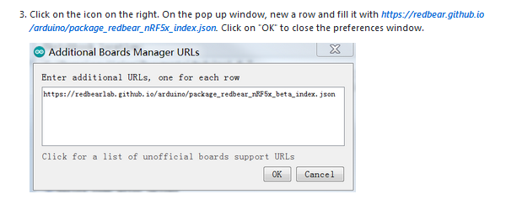
Setup Arduino Red Bear Environment:
See:
https://github.com/redbear/nRF5x/blob/master/nRF52832/docs/Arduino_Board_Package_Installation_Guide.md
To install the board package
Do things like:
(Partial Illustration)

Slide 3
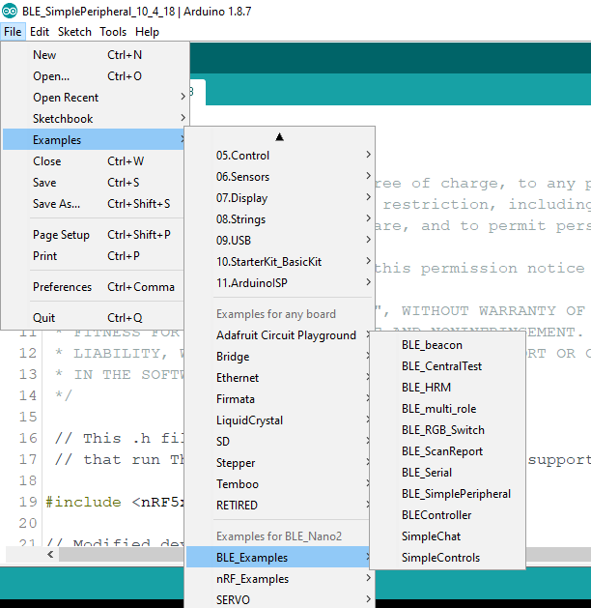
Pick an example sketch, “BLE_Nano2”:

Slide 4
Goal: Demonstrate “Rx from” and “Tx to” Cell Phone
BLE_SimplePeripheral without modification can:
Write characteristic (data) from Cell Phone
Read characteristic to Cell Phone.
Notify characteristic ( Update cell phone every second.)
I also modified BLE Nano sketch to “Loop Back”
Read Characteristic back to C.P. what it wrote earlier

Slide 5
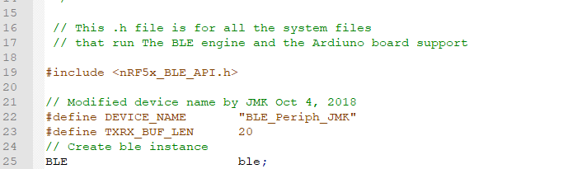
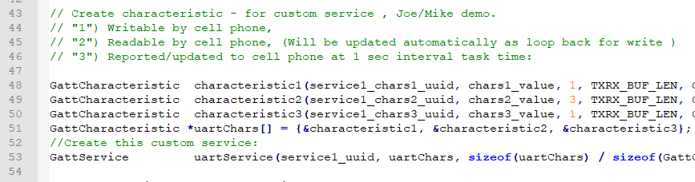
Modify, Explain, Improve:

Slide 6
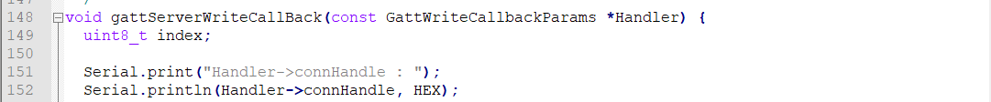
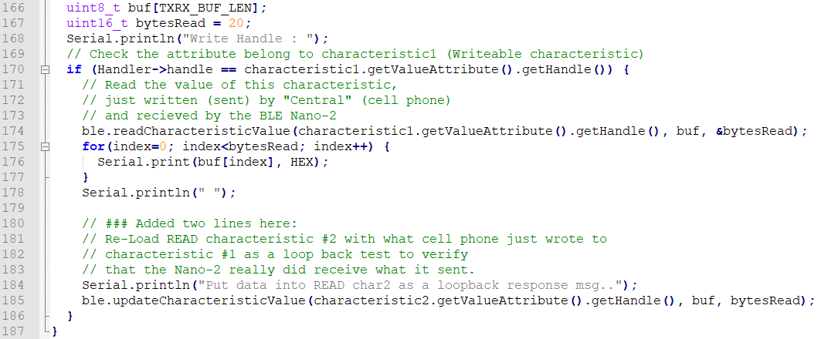
Modify, Explain, Improve, (Slide 2)
.
.
.

Slide 7
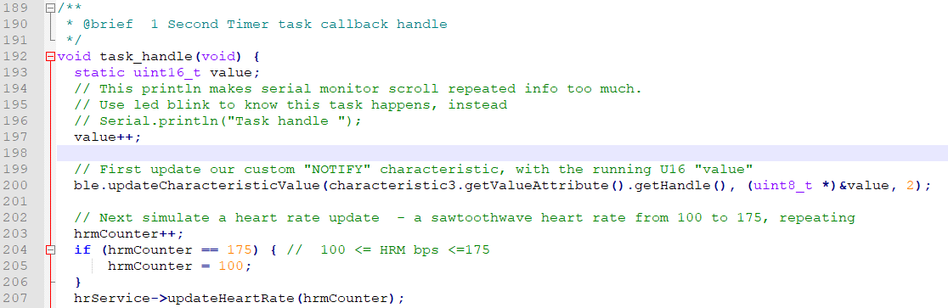
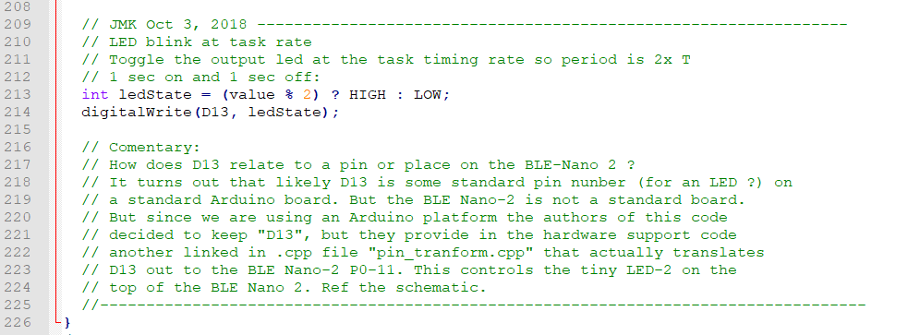
Modify, Explain, Improve, (Slide 3)

Slide 8
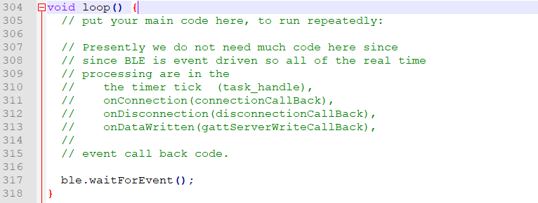
Modify, Explain, Improve, (Slide 4)

Slide 9
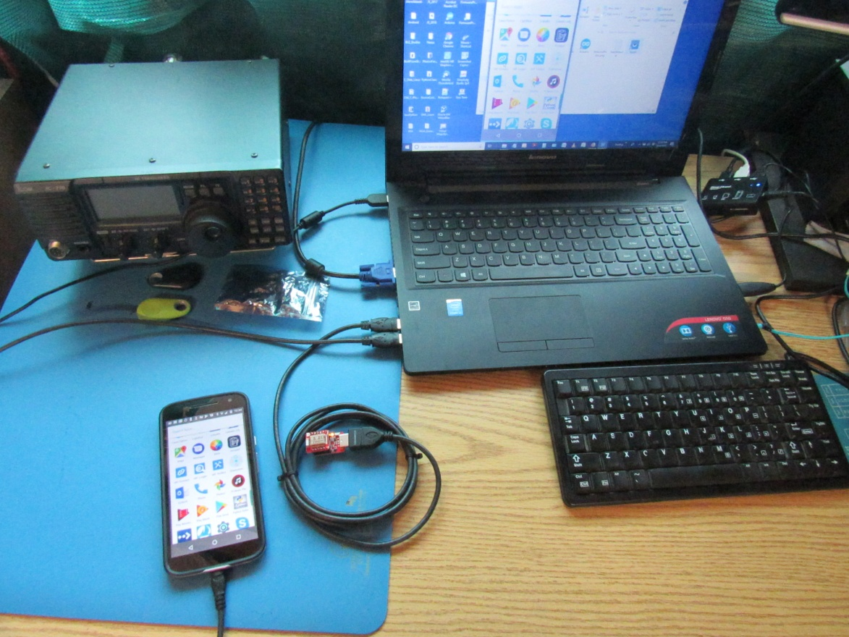
Read / Write, “Mike” and “Joe”:
Use Android “Gphone” ,
Visor for P.C. Control / Display of cell phone
www.visor.io - Free Tool !

Slide 10
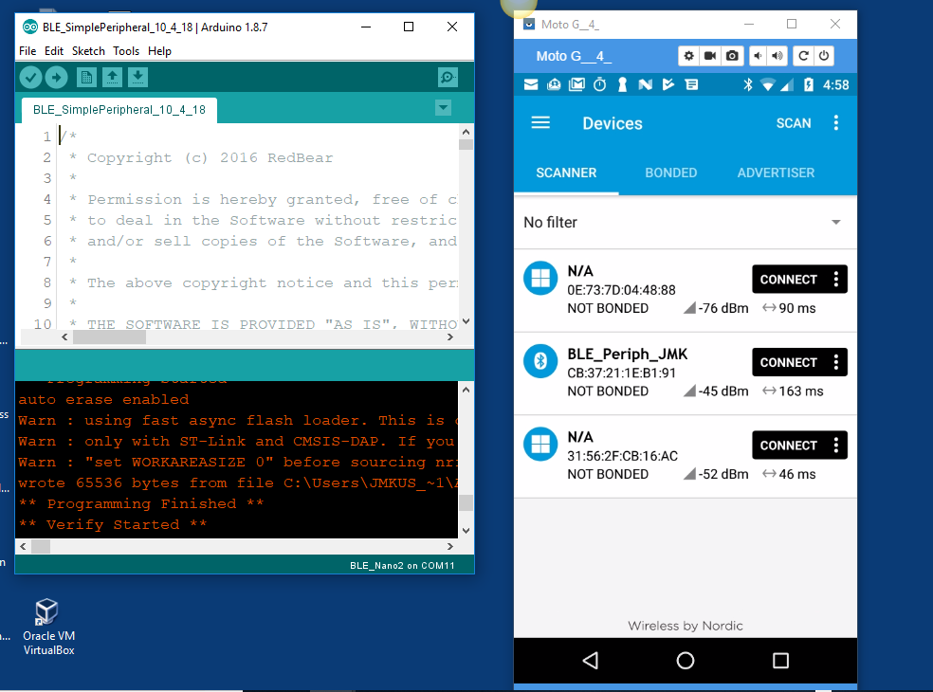
Lets Connect !
Click “Connect” button on Nordic “nRFConect” G-Phone Ap

Slide 11
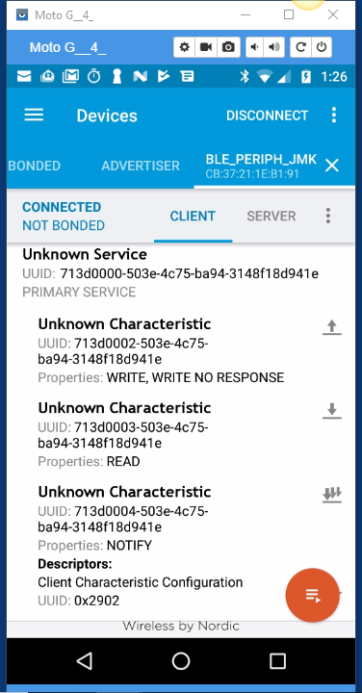
Connected to BLE Nano: Next: Expand “Unknown Service”, then Click on Up arrow - for “Write” Characteristic..

Slide 12
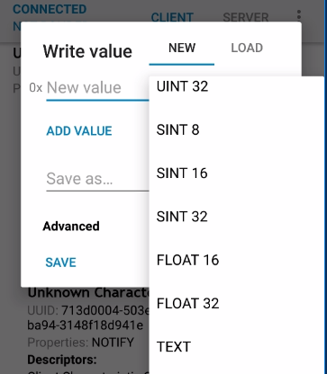
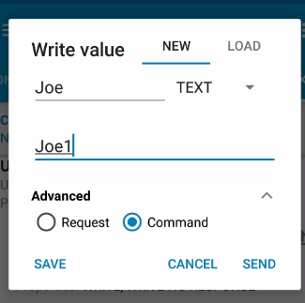
Set up write “Joe” text, and save it
Select “TEXT”, For Advanced select “Command”

Slide 13
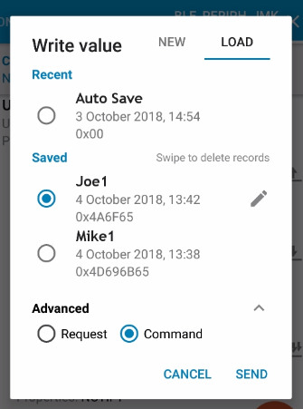
Write “Joe” to the Nano 2
Select “Load”, Click on “Send”

Slide 14
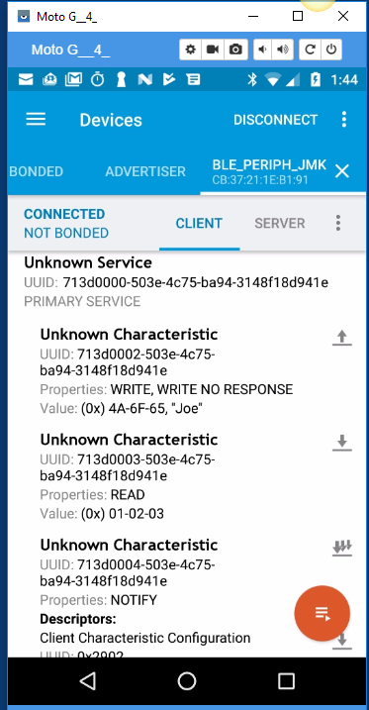
What happens ?
Gphone says ‘Joe’ was written.
But, lets read it back to see if the “dart” actually hit the dartboard..

Slide 15
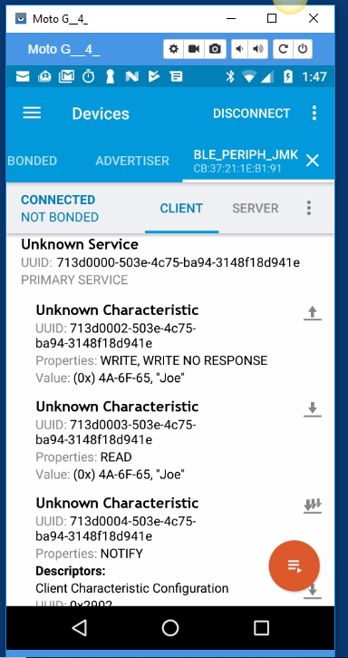
Ask to read update from BLE-Nano:
Clicked on down arrow to ask for a read back
And “Joe” shows up as response from
BLE Nano “Simple Peripheral”
Trust me - This worked for writing “Mike” as well !

Slide 16
Exercise for the Reader
This little demo program also, has a simulated custom “Notify” characteristic, which if you select you will see it changing once/sec.
This little demo program has a simulated “heart rate” monitor function that goes from 100 bpm to 175 bpm every 75 seconds (very sick person)
(But these were stock functionality that I did not modify.)
Finally: For slide deck and source to modified Arduino Sketch see:
http://github/jmkuss/BLE_Nano2Demo

